Slide 1
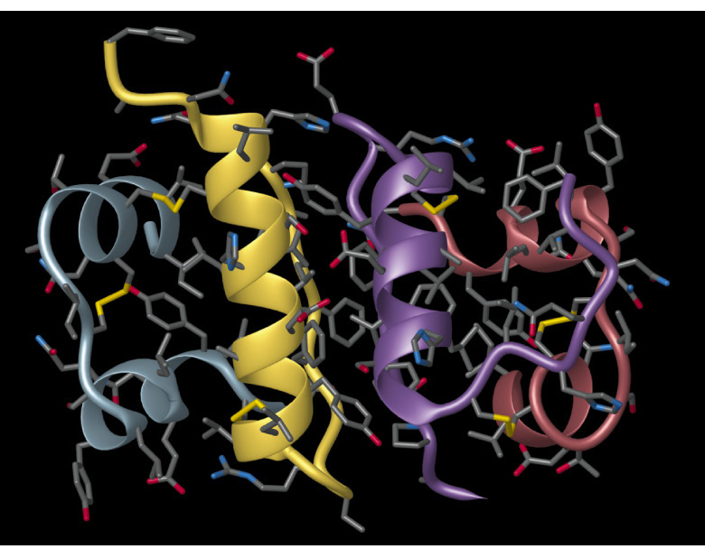
Chapter 28: Chemistry of the Living State
General Chemistry
Principles and Modern Applications
Petrucci • Harwood • Herring
8th Edition
Philip Dutton
University of Windsor, Canada
N9B 3P4
Prentice-Hall © 2002

Slide 2
Contents
28-1 Chemical Structure of Living Matter: An Overview
28-2 Lipids
28-3 Carbohydrates
28-4 Proteins
28-5 Aspects of Metabolism
28-6 Nucleic Acids
Focus On Protein Synthesis and the Genetic Code

Slide 3
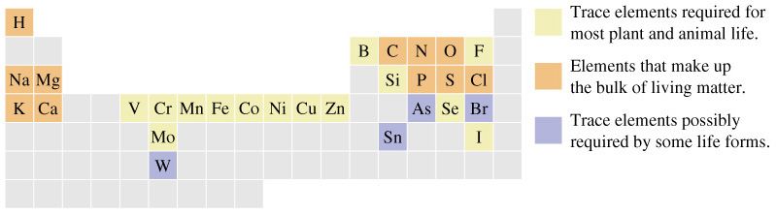
29-1 Chemical Structure of Living Matter:
An Overview

Slide 4
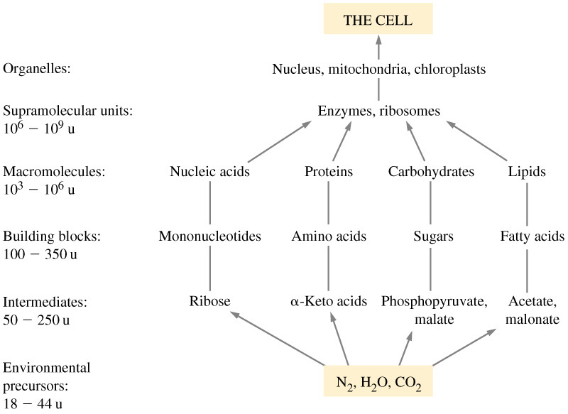
Cellular Organization

Slide 5
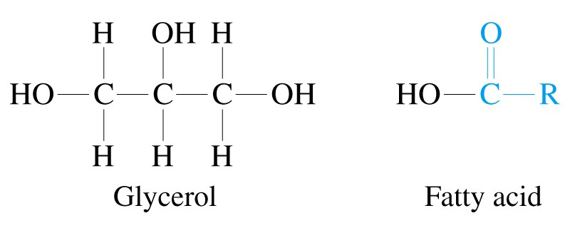
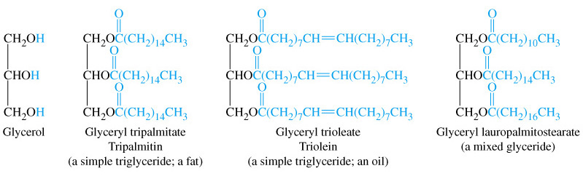
28-2 Lipids

Slide 6
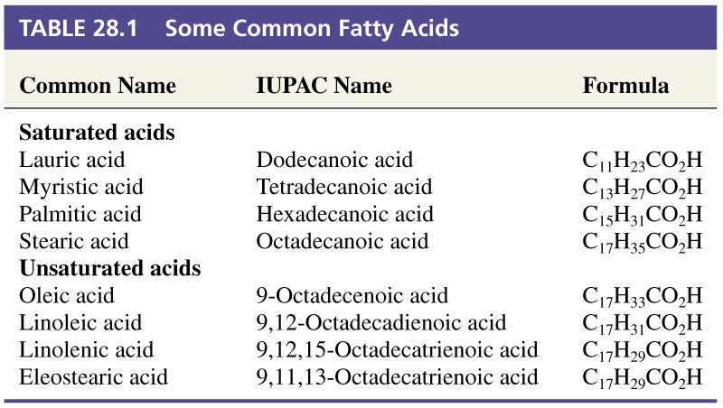
Table 29.1 Some Common Fatty Acids

Slide 7
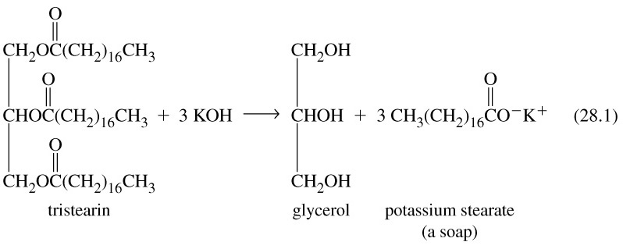
Saponification

Slide 8
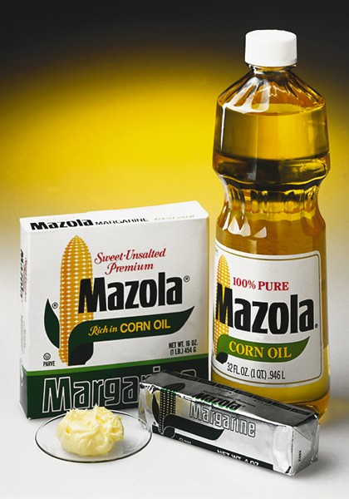
Fats and Oils
Both are triglycerides.
  Differ in the nature of the acid components attached.
  Both are colorless, odorless and tasteless.
    Flavors and aromas come from organic impurites.
Fats.
  Predominantly saturated fatty acids.
  Normally solid at room temperature
Oils.
  Predominantly unsaturated fatty acids.
  Liquids at room temperature.

Slide 9
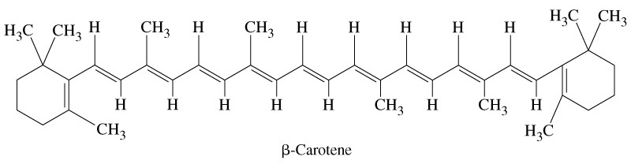
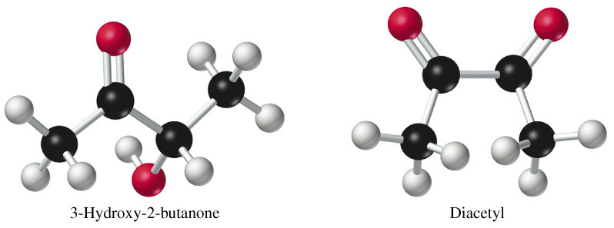
Butter

Slide 10
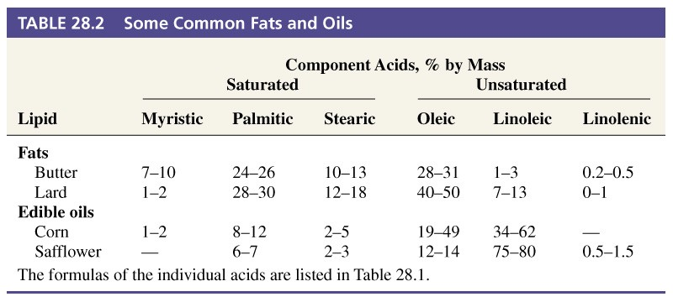
Table 28.2 Some Common Fats and Oils

Slide 11
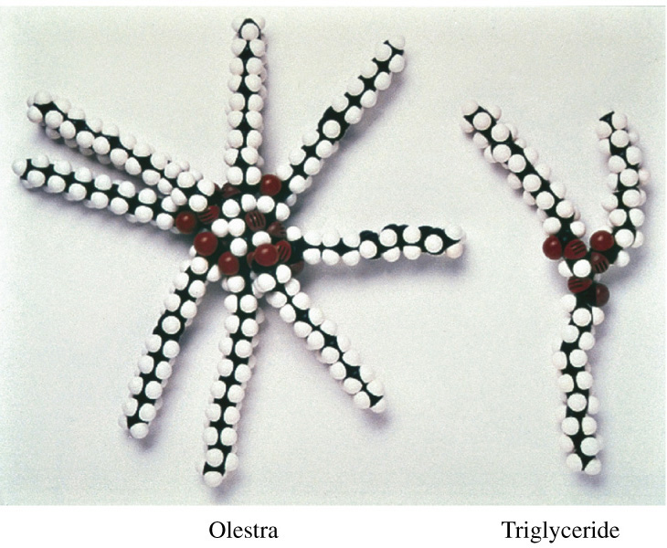
“Calorie-Free” Fats

Slide 12
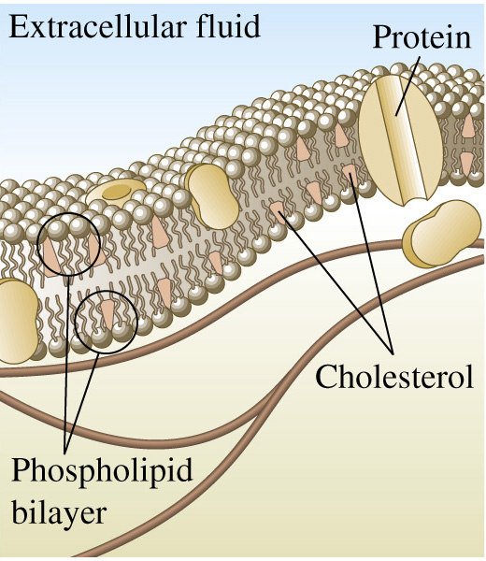
Phospholipids

Slide 13
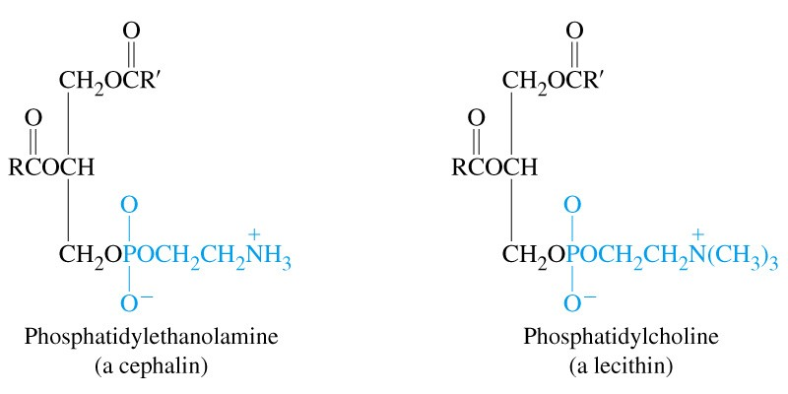
Phospholipids

Slide 14
28-3 Carbohydrates
Hydrates of carbon: C_{x}(H₂O)_{y}.
Monosaccharides.
  The simplest carbohydrates.
Oligosaccharides.
  Two to ten monosaccharides attached together.
Polysaccharides.
  Starch and cellulose.

Slide 15
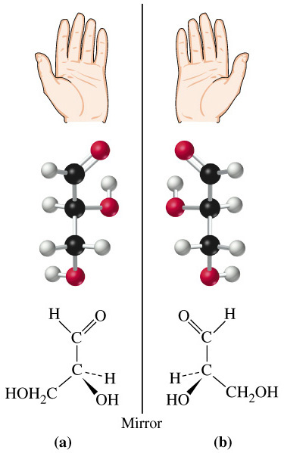
Glyceraldehyde

Slide 16
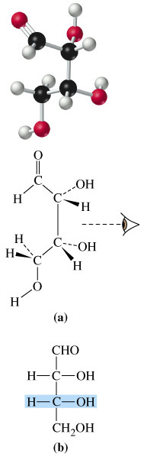
Absolute Configuration
R and S system of nomenclature.
Optical rotation of plane
polarized light.
  Dextrorotatory (+) or
  levorotatory (-).
Fischer Projection formulas
Fischer D,L-convention.

Slide 17
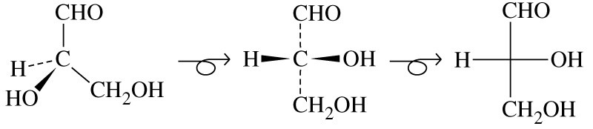
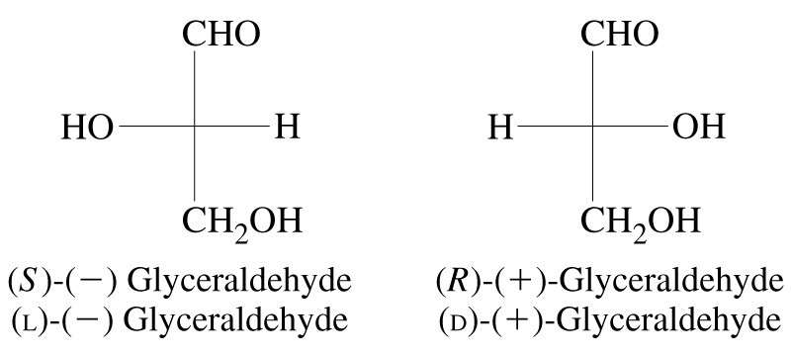
Fischer Projections of Glyceraldehyde

Slide 18
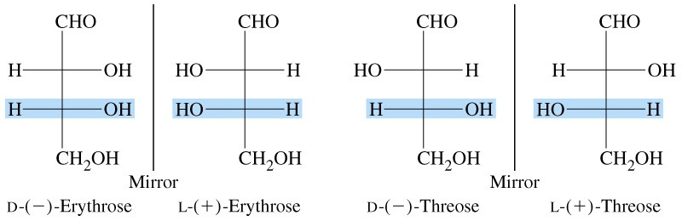
Enantiomeric Relationships in the Aldotetroses

Slide 19
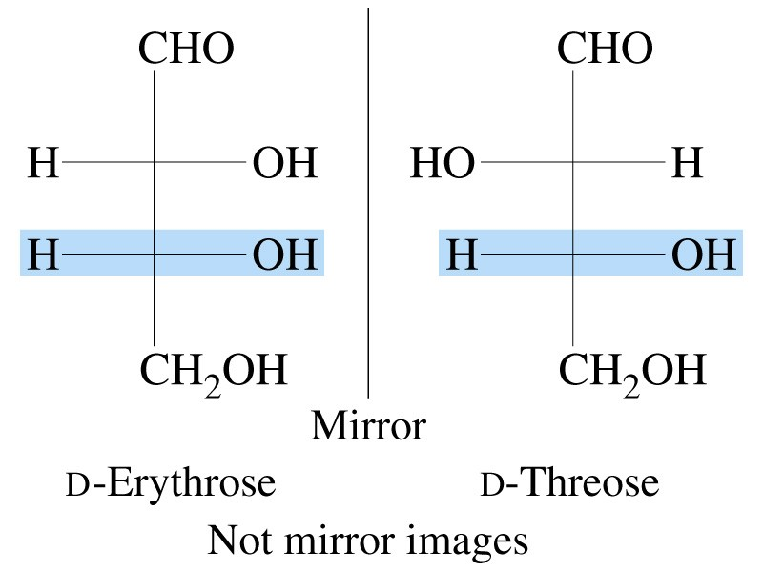
Diastereomeric Relationships

Slide 20
Monosaccharides
Sixteen possible aldohexoses.
  Three occur widely.
    D-glucose, D-mannose and D-galactose.
Predominantly in the cyclic form.
Reducing sugars.
  Reduce Cu²⁺ to Cu₂O and form a brick red precipitate.
  Fehling’s solution (tartrate) or Benedict’s solution (citrate).

Slide 21
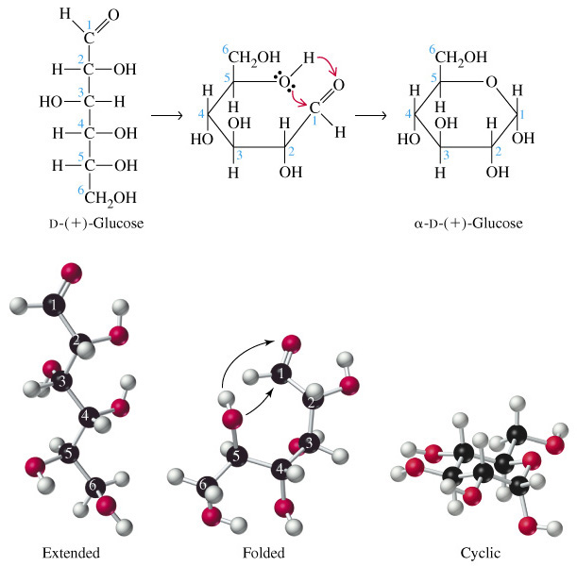
Ring Closure in Glucose

Slide 22
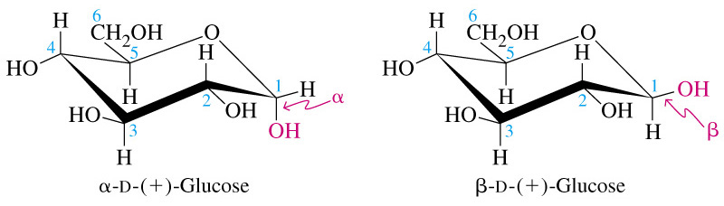
α- and β-D-glucose

Slide 23
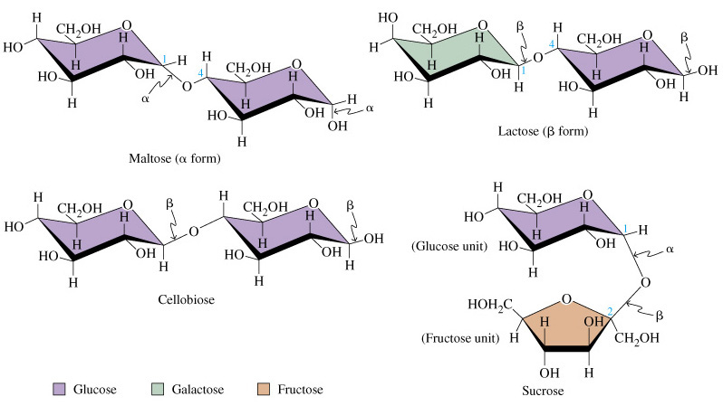
Some Common Disaccharides

Slide 24
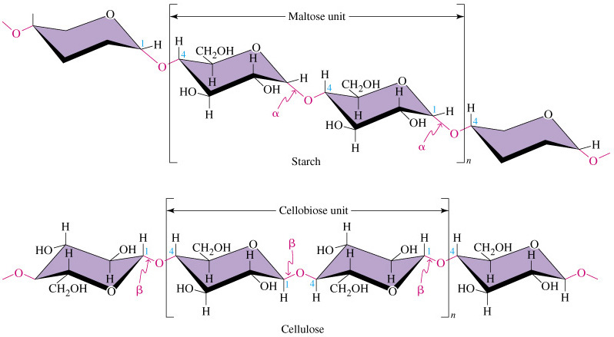
Two Common Polysaccharides

Slide 25
Photosynthesis
Plants convert carbon dioxide and water into carbohydrates via photosynthesis.
  100 sequential steps convert six moles of CO₂ to one mole of glucose.
  Carbon-14 radiolabelling helped to identify individual steps.
Conversion of solar energy to chemical energy.
  Light reactions.
Synthesis of carbohydrates.
  Dark reactions.

Slide 26
Biomass
Any living matter.
Raw material can be used as fuel directly or can be converted into other forms of liquid or solid materials.
  Usually by fermentation.
    Decomposition in the absence of air through the action of a microorganism.

Slide 27
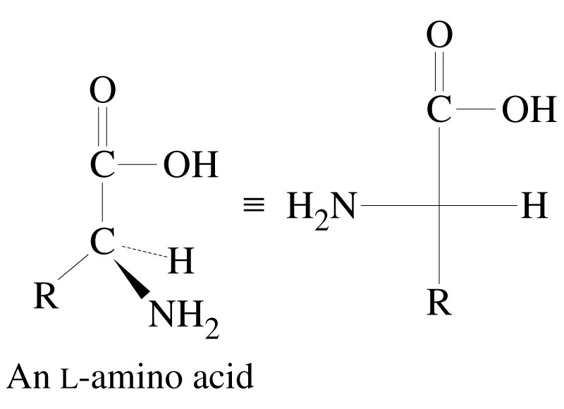
28-4 Proteins

Slide 28
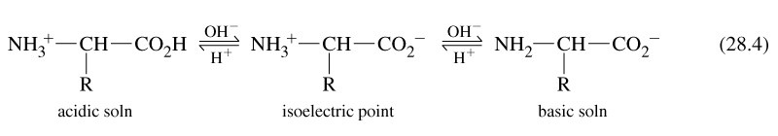
Zwitterionic Form of an Amino Acid

Slide 29
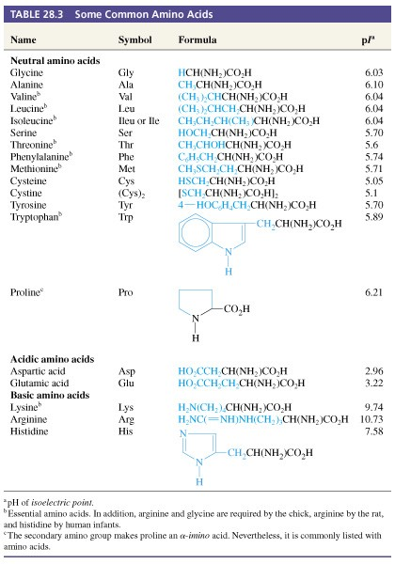
Table 28-3 Some Common Amino Acids

Slide 30
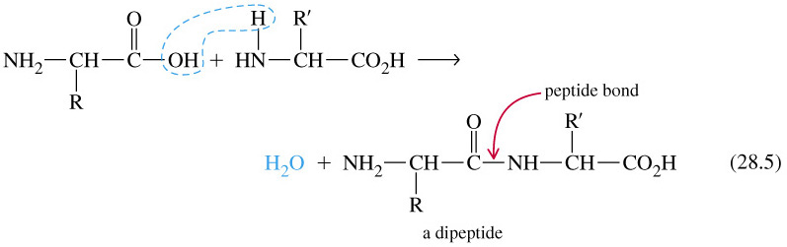
Peptides

Slide 31
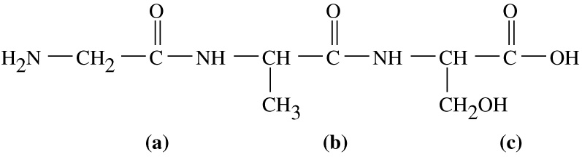
A tripeptide
N-terminal
C-terminal
Gly-Ala-Ser

Slide 32
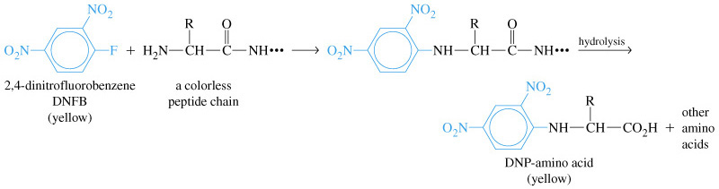
Sequencing

Slide 33
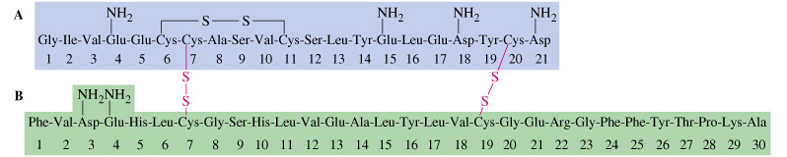
Amino Acid Sequence in Beef Insulin

Slide 34
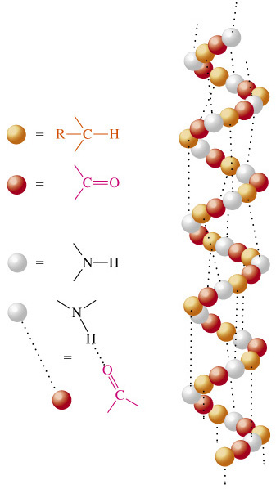
Structure of Proteins: α-Helix

Slide 35
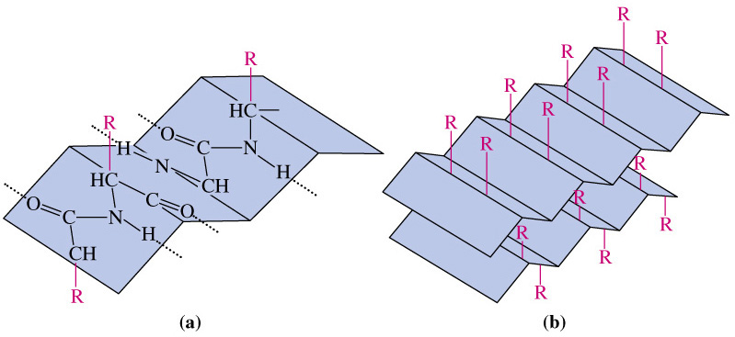
Structure of Proteins: β-Sheet

Slide 36
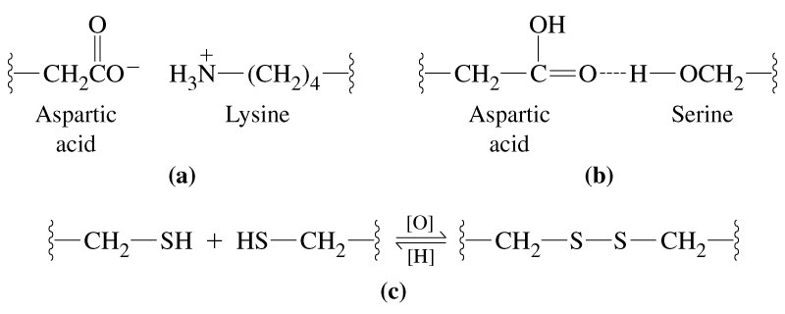
Linkages Contributing to Tertiary Structure

Slide 37
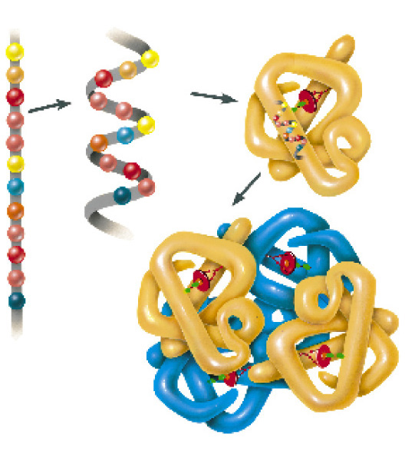
Four Levels of Protein Structure

Slide 38
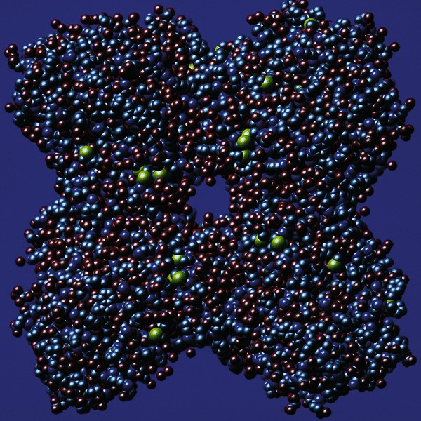
RuBisCo

Slide 39
28-5 Aspects of Metabolism
Metabolism.
    The life process.
  Catabolism.
    Substances are broken down.
  Anabolism.
    Substances are built up.

Slide 40
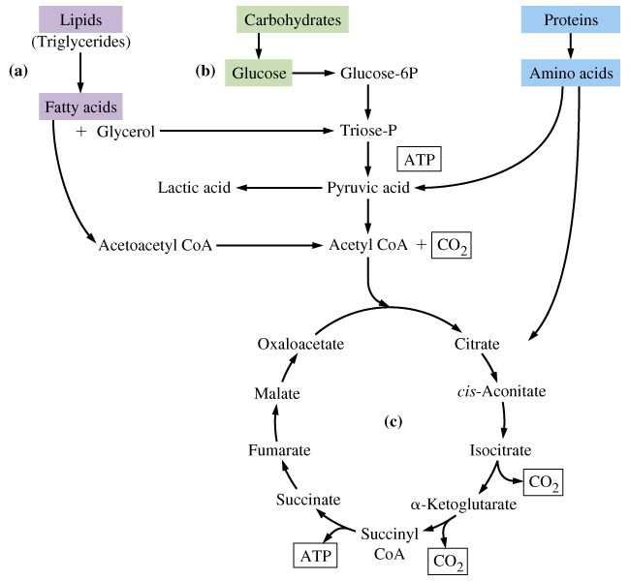
Carbohydrate Metabolism

Slide 41
Metabolism
Lipid metabolism.
  Uptake of fats through walls of intestine.
  Glycerol converted to glyceraldehyde-3-phosphate.
  Fatty acids are oxidized by β–oxidation.
Protein metabolism.
  Stomach:
    HCl and pepsin hydrolize 10% of peptide bonds.
  Intestine:
    Trypsin and chymotrypsin cleave peptide fragments further.

Slide 42
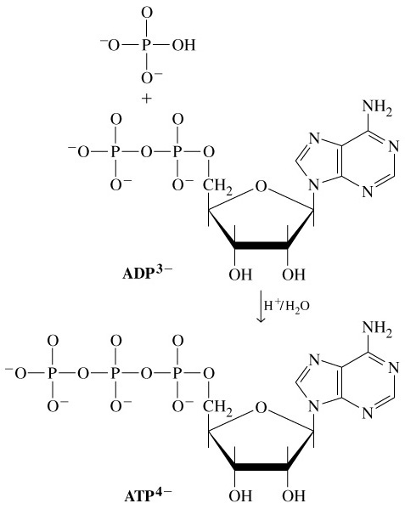
Energy Relationships in Metabolism

Slide 43
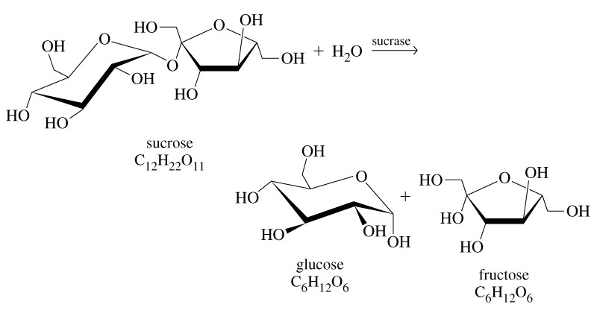
Enzymes
E + S  ES → E + P

Slide 44
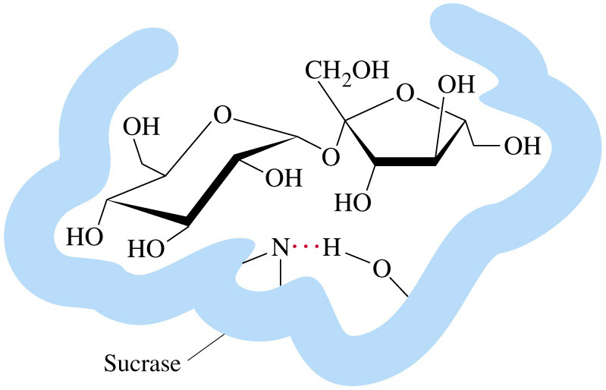
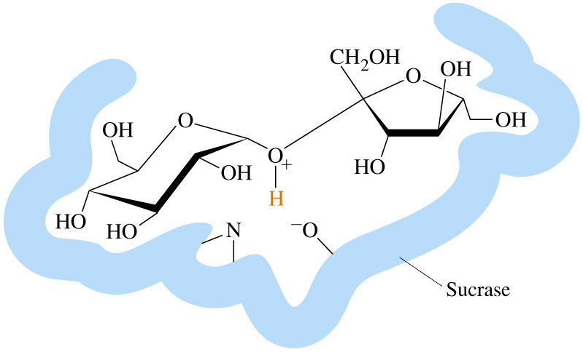
Sucrase Mechanism
→
→

Slide 45
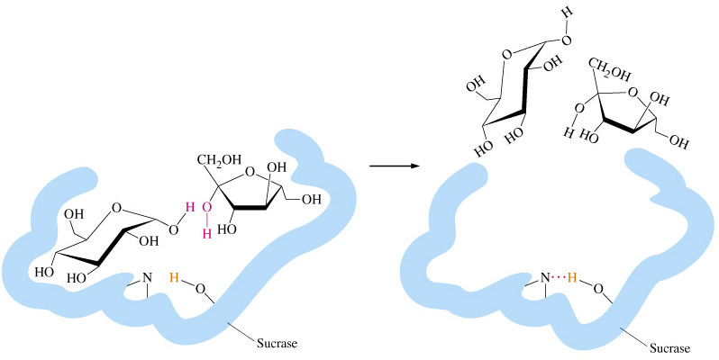
Sucrase Mechanism
→

Slide 46
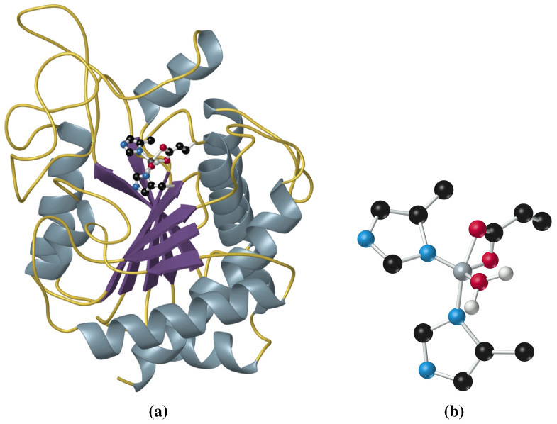
Carboxypeptidase

Slide 47
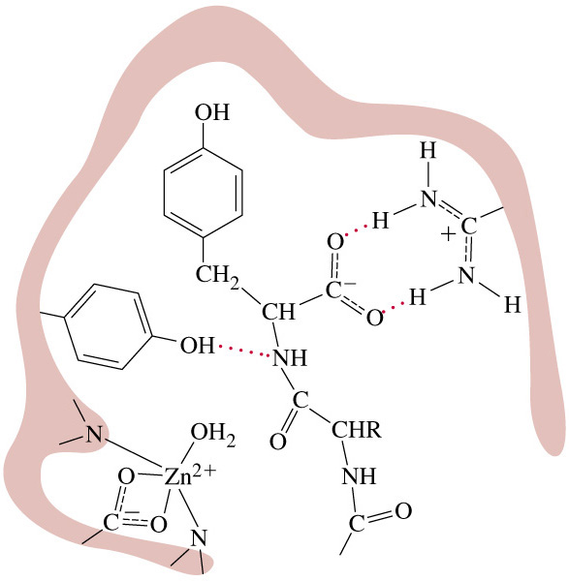
Active Site of Carboxypeptidase

Slide 48
28-6 Nucleic Acids
DNA
  Deoxyribonucleic acid.
    Chromasomes.
      Double stranded DNA rod-like structures.
    Genes.
      Specific locations on chromasomes that code for specific traits.

Slide 49
Nucleic Acids
RNA
  Ribonucleic acid
    Contains ribose instead of deoxyribose.
    Generally single stranded.

Slide 50
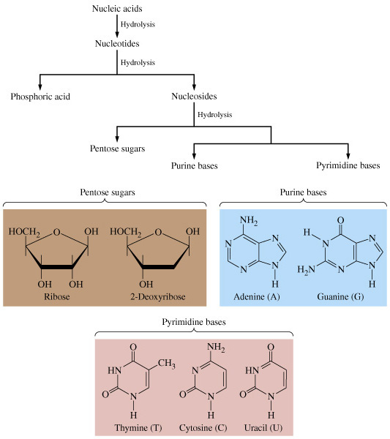
Components of DNA and RNA

Slide 51
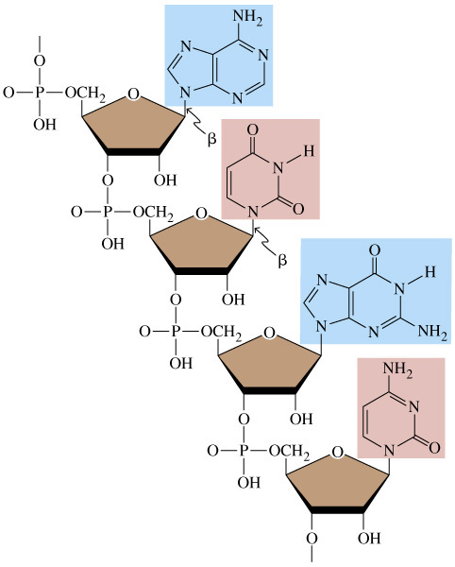
RNA Single Strand

Slide 52
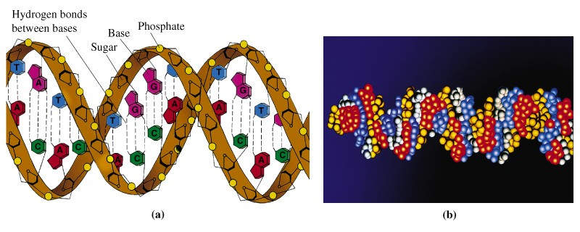
DNA Double Helix

Slide 53
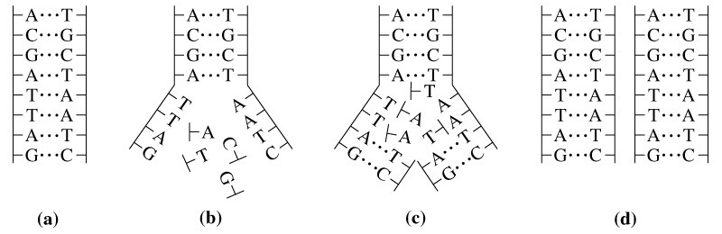
DNA Replication

Slide 54
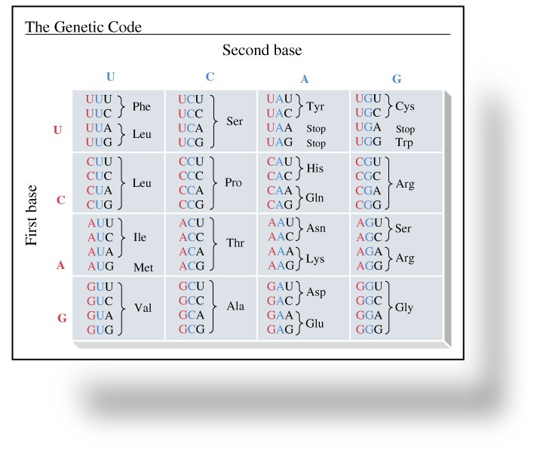
Focus On Protein Synthesis and the Genetic Code

Slide 55
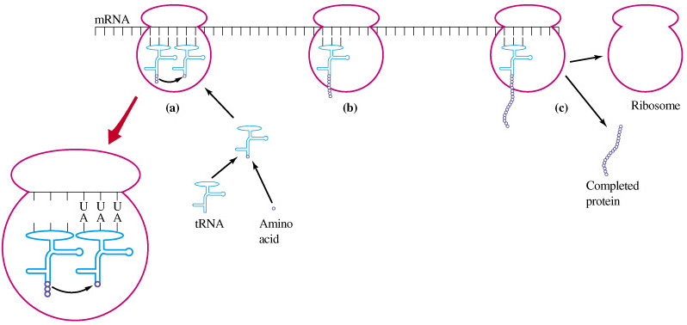
Protein Synthesis

Slide 56
Chapter 28 Questions
Develop problem solving skills and base your strategy not on solutions to specific problems but on understanding.
Choose a variety of problems from the text as examples.
Practice good techniques and get coaching from people who have been here before.

